Slide 1

03
FUNGI
KIT
Plotting Guide

Slide 2

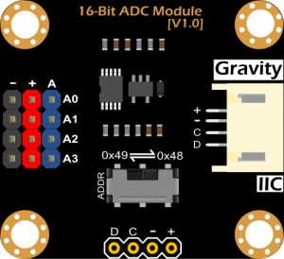

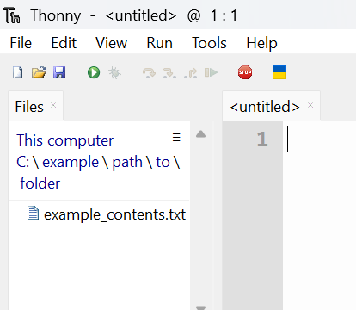
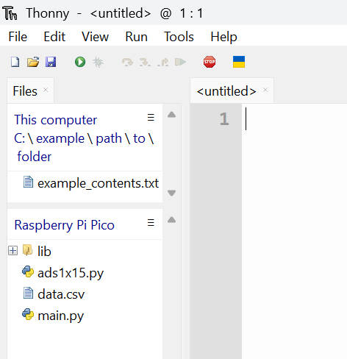
Fungi Kit Plotting Guide
Step 1: Saving the Data from the Raspberry Pi Pico
❗
Disconnect the battery and analogue-to-digital converter (ADC) from the Raspberry Pi Pico by unplugging the wires before continuing.
Reopen Thonny, then plug the Raspberry Pi Pico back into the computer and press the red Stop button to tell Thonny to find it.
fig. 1
We want to save the data file from the Raspberry Pi Pico to a simple location. In the Files tab on the left of Thonny, click on the C:\ (fig. 2).
fig. 2
In the Files window, navigate to Users → [Your Computer Name] → Documents → FungiKit. You should now see a file named fungi_kit_plotter.py.
Note: You won’t see the text “Your Computer Username” — it will show your actual computer name instead.

Slide 3
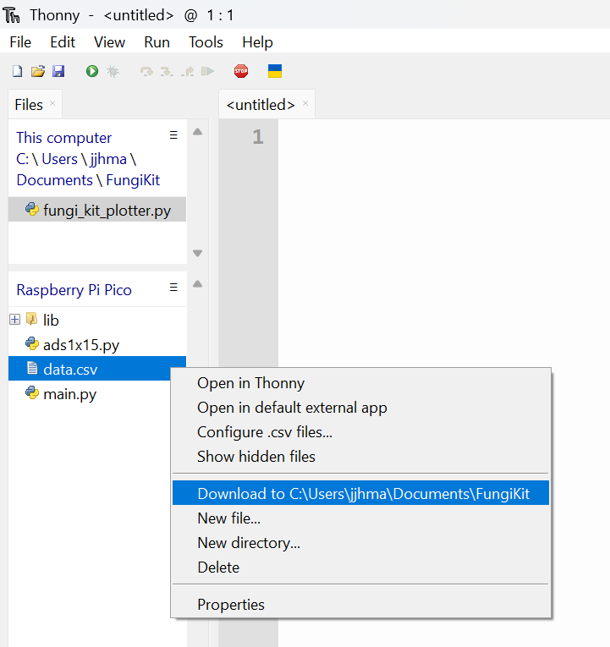
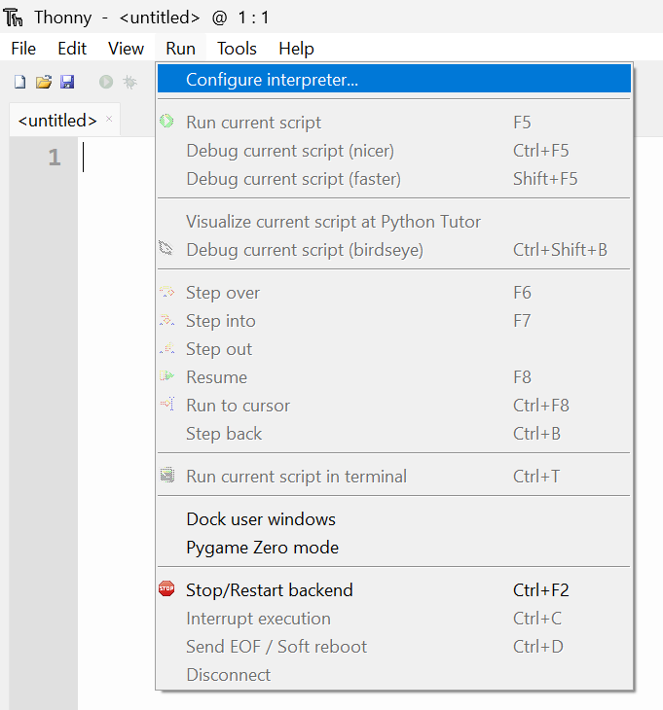
Fungi Kit Plotting Guide
Right-click on the data.csv file and click “Download to C:\Users\[Your Computer Name]\Documents\FungiKit”.
Also open the file fungi_kit_plotter.py file by double clicking it.
fig. 3
Step 2: Configure the Interpreter
Go to the top toolbar and select Run > Configure Interpreter...
fig. 4

Slide 4
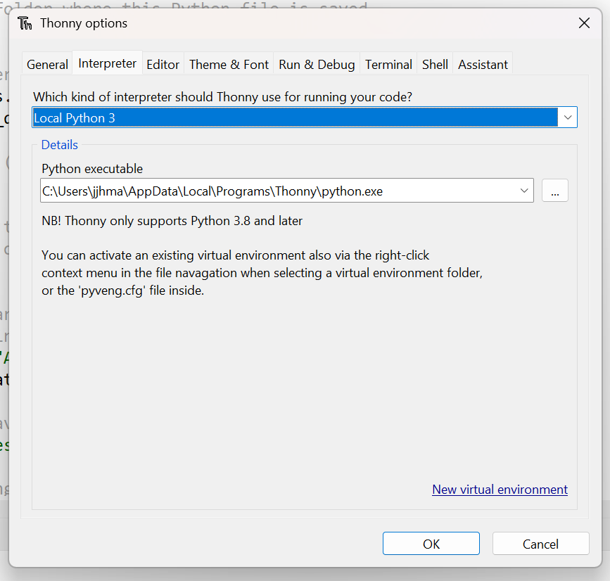
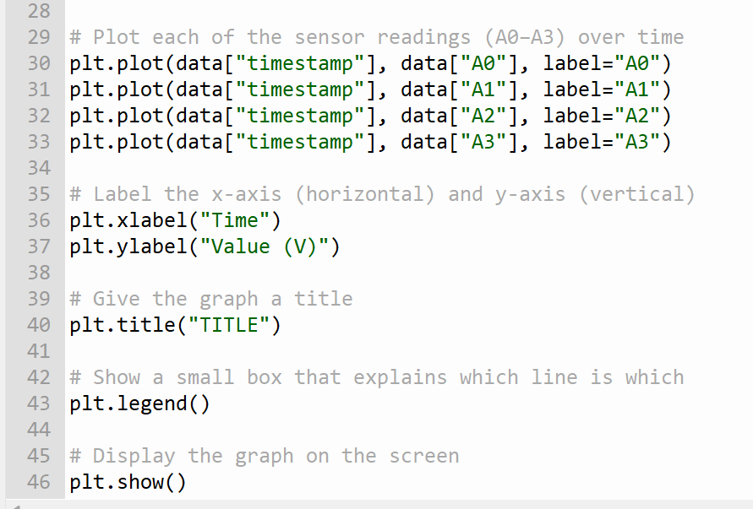
Fungi Kit Plotting Guide
In the first drop-down, select Local Python 3 and then click OK.
fig. 5
Step 3: Plotting the Data
In the fungi_kit_plotter.py file you opened earlier, scroll down and rename the “TITLE”. Make sure to include the date of the recording taken in your title.
fig. 6

Slide 5
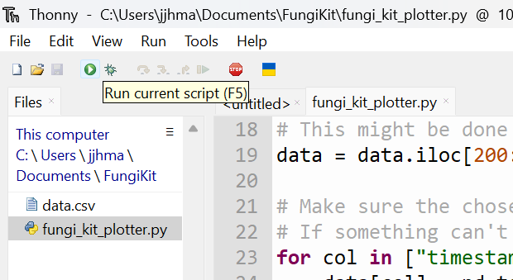
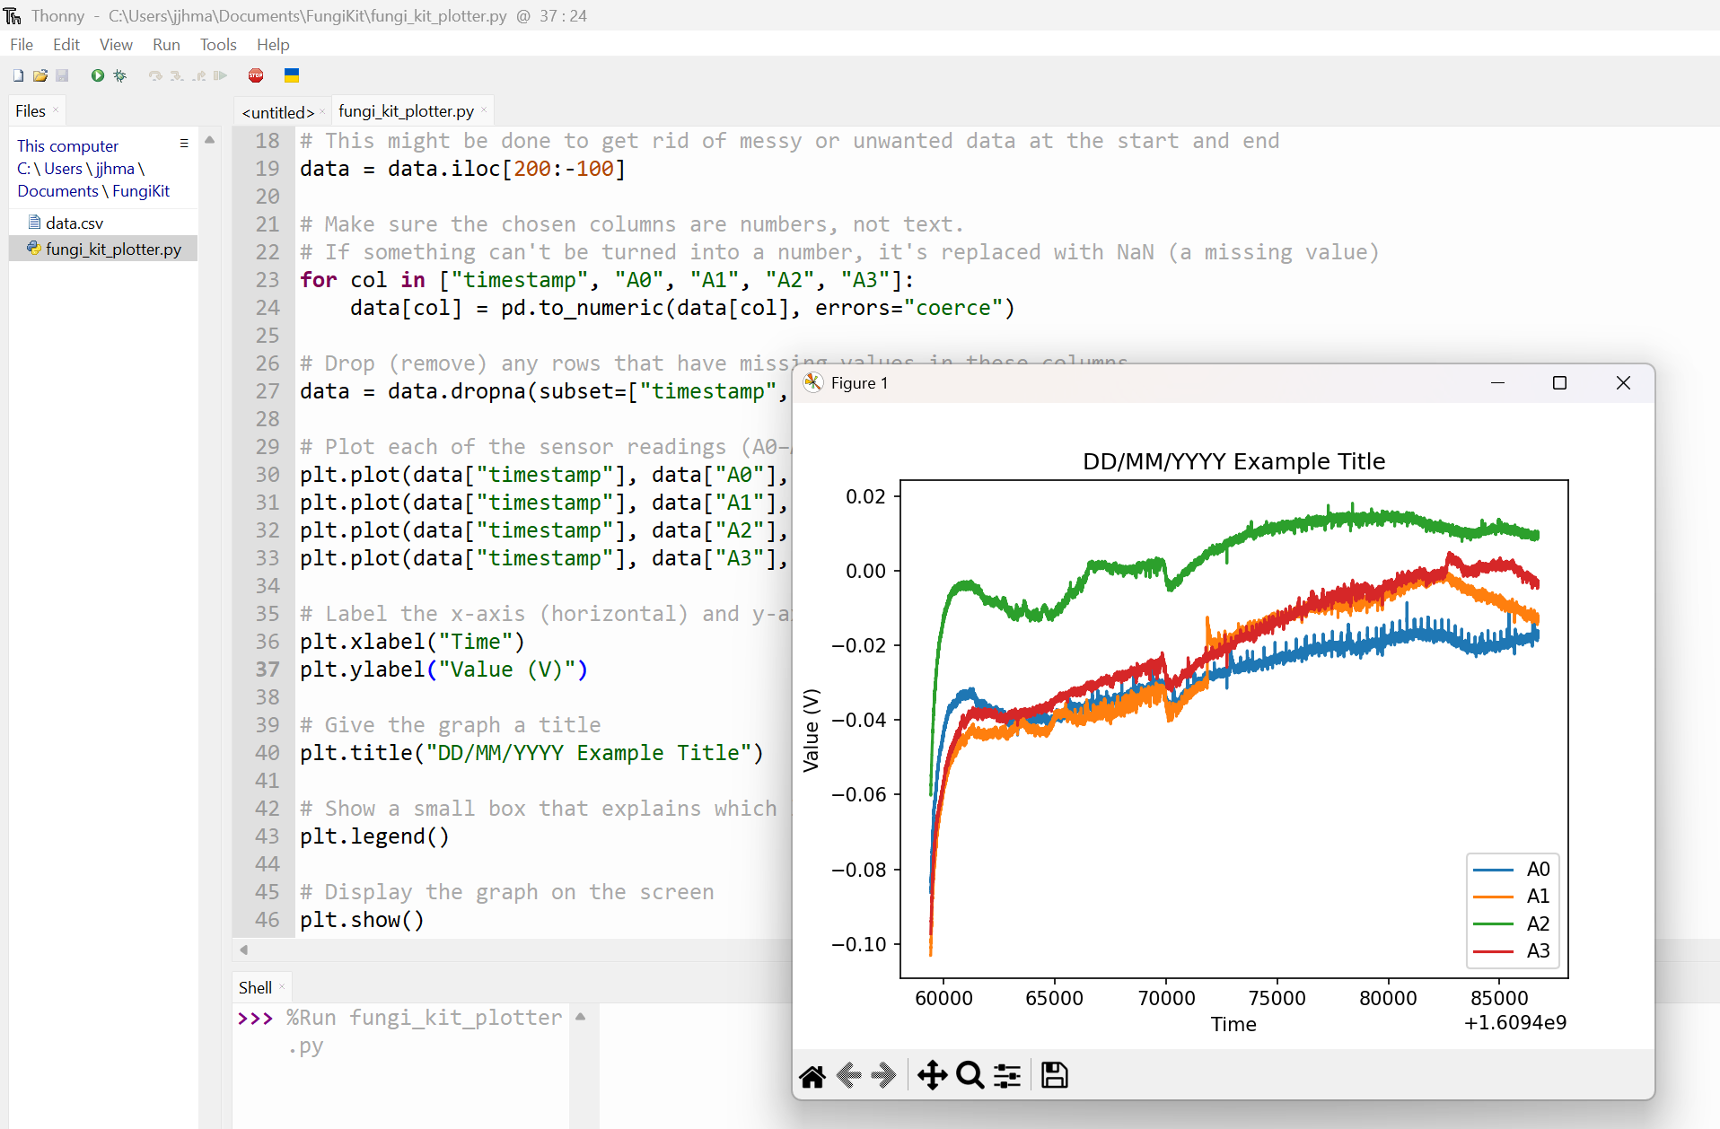
Fungi Kit Plotting Guide
Click the Green Play Button in the top left corner of Thonny to run the program.
fig. 7
After a few seconds, a new window will open with your data plot
fig. 8
Congratulations! You have now finished recording and plotting your data. Your teacher and the tutors will now explain how to analyse the recording.
If you have finished this task quickly, flip over to the next page for an extension task.

Slide 6
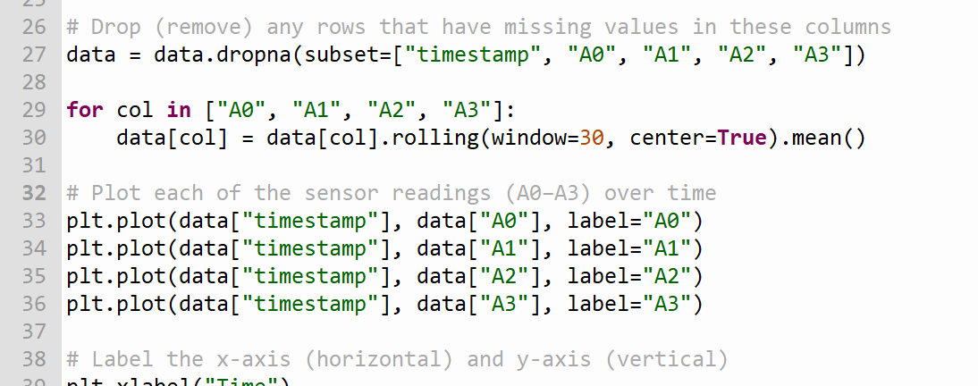
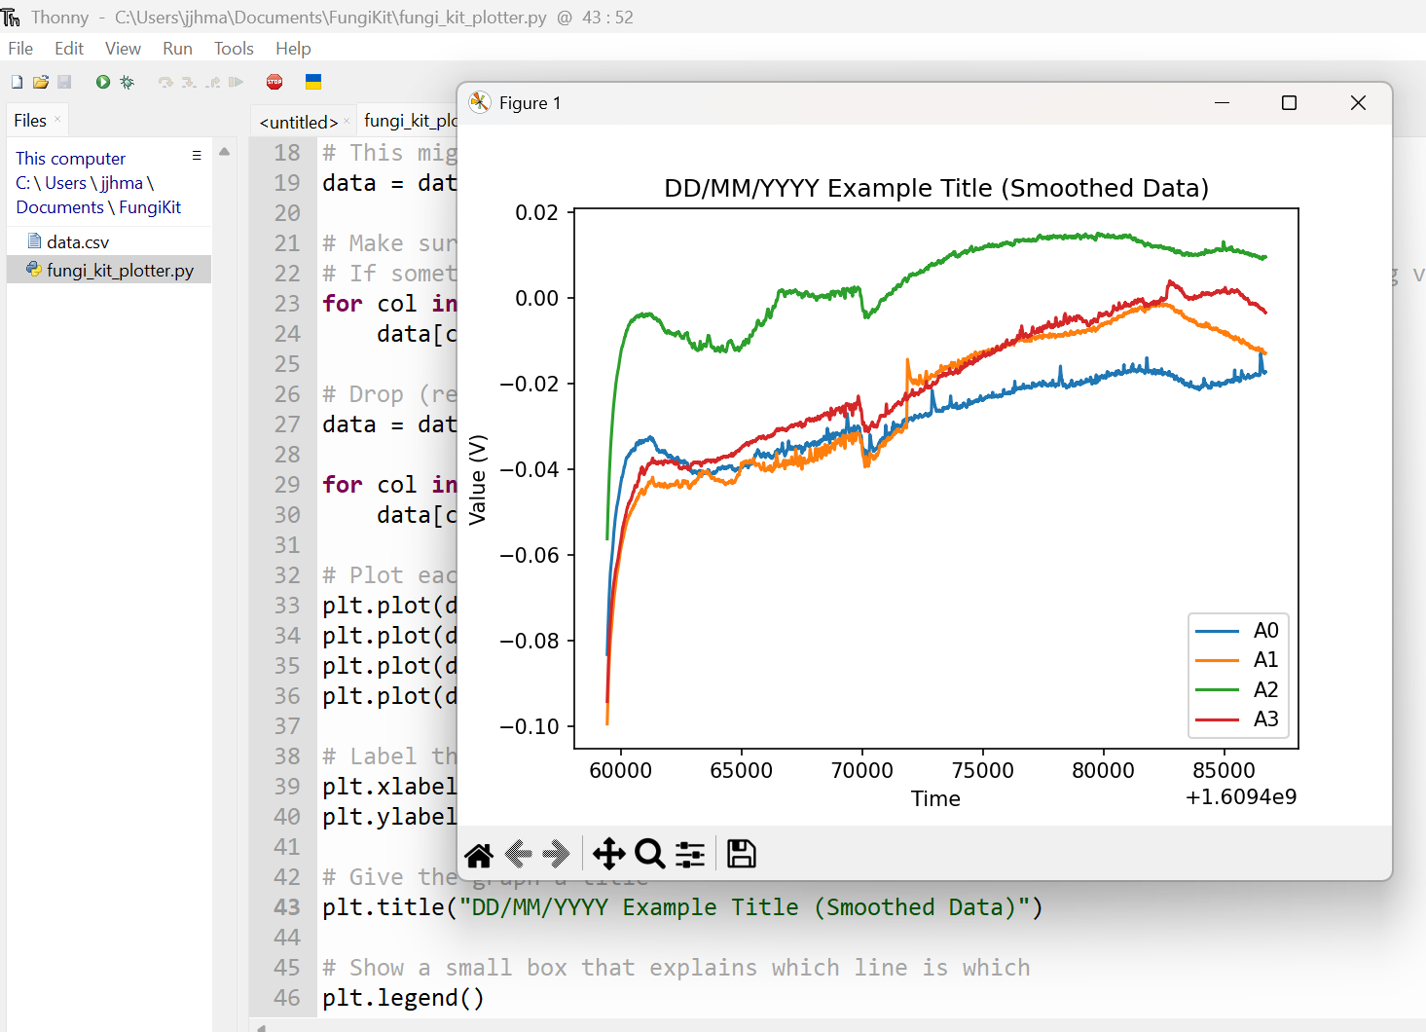
Fungi Kit Plotting Guide
Extension Task: Smoothing the Data with Filtering
You may notice that the data you plotted is quite noisy, which means it jumps up and down a lot instead of following a smooth trend. Noisy data can happen for many reasons, like small measurement errors or natural variations in the mushrooms. To better see the overall pattern, we can use a method called filtering to smooth the data. Filtering reduces the random ups and downs, making it easier to spot trends and understand what the data is really showing.
To filter the data, we need to add a few more lines of code before plotting the data. Add the following highlighted lines of code (fig. 9).
fig. 9
Run the script again using the Green Play Button.
You should see that the data on the new plot is smoothed, and the spiking activity is more clearly visible.
fig. 10
Experiment with different window sizes by changing the number in [window=VALUE] and observe how it changes the graph.

